Slide 1
Identity Policies and AWS Organization
Here, we’ll know about IAM Identity Policies and AWS Organization

Slide 2
IAM Identity Policies
IAM (Identity and Access Management) identity policies are used to define permissions for AWS resources, specifying what actions are allowed or denied for IAM users, groups, or roles. These policies are written in JSON format and consist of statements that describe the actions (e.g., s3:PutObject), the resources (e.g., an S3 bucket), and the effect (either allow or deny). Policies can include conditions to further specify when and how they apply.
There are two main types:
Managed policies, which are reusable and can be attached to multiple identities.
Inline policies, which are directly embedded within a specific IAM identity.
These policies enable granular control over who can access which AWS resources and actions, such as granting permissions, restricting access, or delegating actions.

Slide 3
IAM Users and ARN’s
IAM Users are entities created within AWS Identity and Access Management (IAM) to represent individual people or applications that interact with AWS resources. Each IAM user has a unique identity with specific permissions assigned to them via policies, allowing them to access AWS services and perform actions according to their defined roles. IAM users are primarily used to grant specific permissions for accessing resources in an AWS environment securely.
ARNs (Amazon Resource Names) are unique identifiers for AWS resources. Each AWS resource, such as an S3 bucket, EC2 instance, or IAM user, is assigned an ARN that helps uniquely identify it across the AWS cloud. ARNs follow a specific format that includes the service name, region, account ID, resource type, and resource ID, and are used in IAM policies to refer to specific resources. For example, an ARN for an S3 bucket might look like arn:aws:s3:::my-bucket-name. ARNs allow precise identification and access control of resources across AWS services.

Slide 4
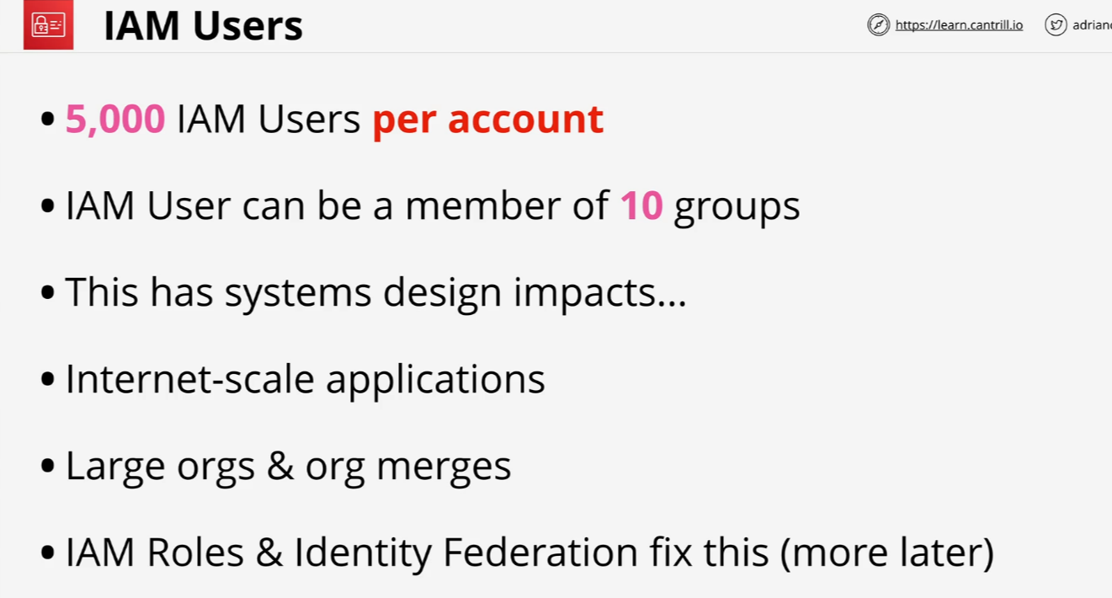
Exam Powerup!

Slide 5
IAM Roles
IAM Roles in AWS are entities that define a set of permissions for making AWS service requests but are not directly associated with a specific user or group. Instead, roles are assumed temporarily by trusted entities, such as IAM users, AWS services, or applications, allowing them to perform actions based on the permissions defined in the role.
Roles are particularly useful when granting access to AWS resources without sharing long-term credentials, such as access keys. Common use cases for IAM roles include granting EC2 instances permissions to access S3 buckets, enabling cross-account access, or allowing Lambda functions to interact with other AWS services. They ensure secure, temporary access to AWS resources based on specific needs.

Slide 6
IAM Groups
IAM Groups in AWS are collections of IAM users that allow for easier management of permissions. Rather than assigning permissions to individual users, you can assign permissions to a group, and all users within that group inherit those permissions. This simplifies the management of permissions, especially when dealing with large numbers of users who need similar access to AWS resources. For example, you could create a group for developers and assign permissions to access EC2 instances or S3 buckets, and all users added to that group would automatically have those permissions. IAM groups help organize users based on their roles or responsibilities, streamlining access control in an AWS environment.

Slide 7
Service-linked Roles & PassRole
Service-linked roles are a type of IAM role that is predefined by AWS and directly associated with specific AWS services. These roles enable AWS services to perform actions on your behalf, such as managing resources or accessing other services required for their functionality. AWS automatically creates, configures, and manages service-linked roles, ensuring that they have the minimum required permissions for the service to operate. For example, AWS Auto Scaling uses a service-linked role to access resources and manage scaling policies. Service-linked roles are tightly integrated with their associated services and cannot be modified or deleted manually unless the service itself is disabled.
The PassRole permission in AWS IAM allows a user or service to pass an IAM role to an AWS service that uses the role to perform actions on the user's behalf. For example, when launching an EC2 instance, you can assign an IAM role to the instance, enabling it to access other AWS resources like S3 or DynamoDB. However, to do this, the user or service must have the iam:PassRole permission explicitly granted. This permission is critical for ensuring that only authorized users or services can assign roles with specific permissions, enhancing security and control over resource access.

Slide 8
AWS Organization
AWS Organizations is a service that allows centralized management of multiple AWS accounts within a single organization. It helps enterprises streamline account management, implement consolidated billing, and enforce governance policies across accounts using Service Control Policies (SCPs). Organizations enable administrators to group accounts into Organizational Units (OUs) for better resource and permission management. This service is ideal for businesses with multiple teams or projects, as it ensures security, simplifies billing, and enhances control over resources.

Slide 9
AWS Organization
------Steps to Add an Existing Account to AWS Organizations:
Sign in to the Management Account:
Log in to the AWS Management Account (formerly the master account) in the AWS Management Console.
------Go to AWS Organizations Console:
Navigate to the AWS Organizations service in the console.
------Send an Invitation:
Select the Accounts tab and click Invite Account.
Enter the email address or account ID of the account you want to add.
Send the invitation.
-------Set Up IAM Role in the Invited Account:
Log in to the invited account and create an IAM role that the AWS Organizations service can assume.
The role should have a trust relationship that allows the Management Account to access it.
Attach a policy like FullAWSAccess or a custom policy with permissions needed for the organization.
-------Accept the Invitation:
In the invited account, go to AWS Organizations and view the received invitation.
Accept the invitation to join the organization.
--------Verify and Organize:
Return to the Management Account and check that the new account appears in the Accounts list.
Optionally, move the account into an Organizational Unit (OU) and apply Service Control Policies (SCPs) as needed.

Slide 10
Service Control Policies
Service Control Policies (SCPs) are governance tools in AWS Organizations that define the maximum set of permissions available to accounts within an organization or its organizational units (OUs). SCPs do not grant permissions but act as a filter, limiting what IAM policies or other permissions can allow. They apply to all identities in an account, including the root user, ensuring consistent control across the organization. SCPs are JSON-based and can be used to allow or deny specific actions, enforce compliance, or restrict access to certain AWS services. For example, you can use SCPs to allow only S3 and EC2 actions or prevent sensitive operations like deleting logs. SCPs help maintain security and compliance in multi-account AWS setups by governing permissions at a broad level.

Slide 11
CloudWatch Logs
Amazon CloudWatch Logs is a service that enables monitoring, storage, and access to log data from various AWS resources, applications, and services. It collects logs from sources like EC2 instances, Lambda functions, and on-premises systems, storing them in log groups for easy access and management. With CloudWatch Logs, you can monitor specific log patterns, track errors, and set alarms for operational insights. It also supports real-time log analysis and can integrate with other AWS services like AWS Lambda or Elasticsearch for advanced processing. This service is essential for troubleshooting, performance optimization, and ensuring application reliability.

Slide 12
CloudTrail
AWS CloudTrail is a service that records and monitors all actions taken within your AWS account, providing a detailed log of API requests made to AWS services. It tracks activities such as resource creation, modification, and deletion, capturing details like the identity of the requester, the time of the action, and the source IP address. CloudTrail logs are stored in an S3 bucket, allowing for long-term storage, analysis, and compliance auditing. This service is essential for ensuring accountability, detecting unusual activities, and meeting regulatory requirements by maintaining a comprehensive history of account activity.

Slide 13
AWS Control Tower 101
What is AWS Control Tower?
AWS Control Tower is a service that simplifies the setup and governance of a multi-account AWS environment. It provides a secure, scalable framework called a landing zone, which is pre-configured with best practices for security, compliance, and account management. This service is particularly useful for enterprises and organizations managing multiple AWS accounts, as it automates key processes and enforces governance standards.
Core Features of AWS Control Tower?
AWS Control Tower offers several essential features to streamline multi-account management. The landing zone serves as a secure foundation for all accounts, pre-configured with security and networking best practices. Guardrails enforce security and compliance rules across accounts, while the Account Factory automates the creation of new accounts with consistent configurations. Additionally, centralized management integrates seamlessly with AWS Organizations for unified control.

Slide 14
AWS Control Tower 101
How AWS Control Tower Works?
AWS Control Tower works by setting up a landing zone as a baseline environment. Accounts created through the Account Factory inherit the configurations and guardrails automatically. Governance is maintained through the application of guardrails, which ensure all accounts comply with organizational standards. Monitoring tools like AWS CloudTrail and AWS Config provide continuous visibility into account activity and compliance.
Use Cases?
AWS Control Tower is ideal for enterprises managing multiple AWS accounts, startups scaling quickly, and industries with strict compliance requirements. It ensures governance and security as organizations grow, simplifies adherence to regulations like GDPR or HIPAA, and provides a robust framework for managing resources efficiently.

Slide 15
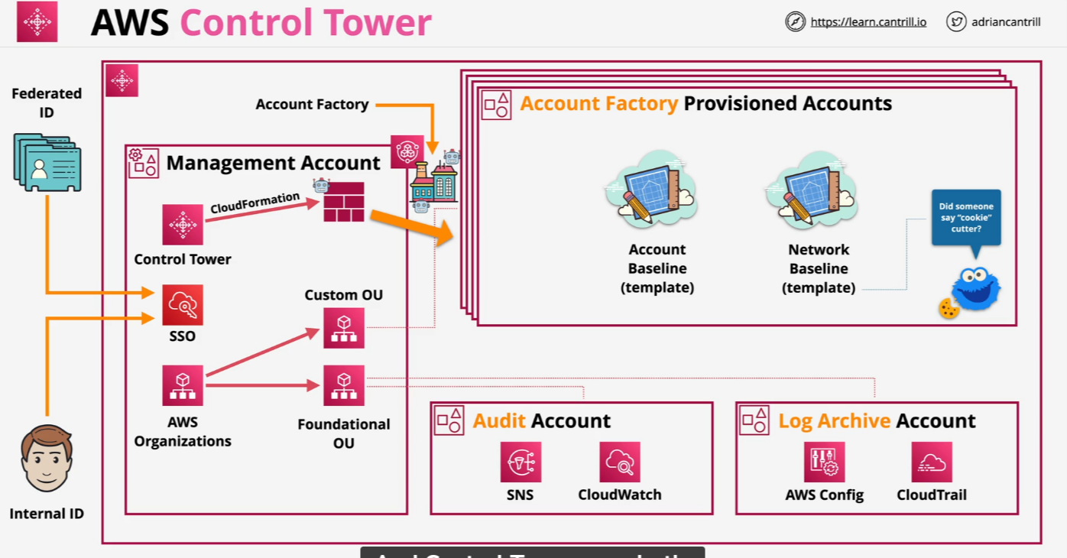
AWS Control Tower 101

